Slide 1

Predict Market Growth
Using
Machine Learning

Slide 2

What are we solving?
We are addressing the critical issue of predicting market growth rates within the construction industry.
This implies that we aim to:
- Anticipate market trends and growth trajectories accurately.
- Identify emerging opportunities and competitive dynamics in the construction sector.
- Enable businesses to make informed strategic decisions based on reliable forecasts.
- Ultimately, strive for sustainable growth and a competitive edge in the market landscape.

Slide 3
Why does it matter?
Current challenges
Poor financial performance of a business as they did not understand market behavior and did not invest to grow their business in it.
Predicted market bullish but it turned to be bearish, so company did not seize open opportunities in other markets and their financial performance suffered.
Adaptive Strategies: In the face of complexity and rapid change, businesses must adopt agile and adaptive strategies. Predicting market provides scenario planning, seize opportunities, and mitigate risks in an ever-evolving economic landscape.

Slide 4
What can we do to achieve this?
Machine learning can help
Analyze vast amounts of data to identify patterns and trends that humans might overlook.
ML algorithms can continuously learn from new data, improving prediction accuracy over time.
ML enables the development of sophisticated predictive models that can forecast future outcomes based on historical data.
As a part of this exercise, we are going to make it predictive enough to tell which direction market is heading (Bullish , Bearish or Neutral) and what will be the price of commodity Stainless Steel and Construction market revenue in next 2 years

Slide 5
How did we achieve this?
Collected data for Economy predicators including Stainless Steel price, GDP, Inflation and interest rate, Company’s stock performance and Construction Market
Cleaned the data and performed Feature Engineering to drive insights
Built Predictive Models using Economy data to tell whether market is Bullish, Bearish or Neutral.
Built Forecast Models using SARIMA for Stainless-steel price in next 2 years
Built Forecast Models using Random Forest Regressor to predict Construction market Performance. Moreover, used forecasted data from renowned data source like Dodge and compare our model performance in future.

Slide 6
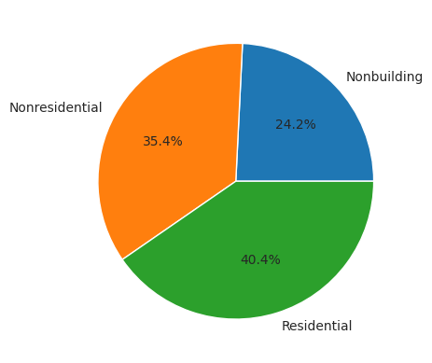
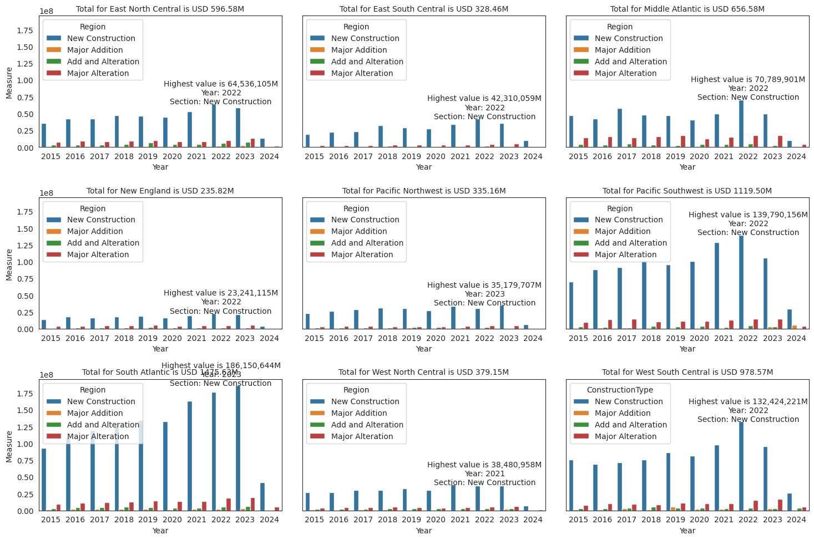
Construction Market Insight

Slide 7
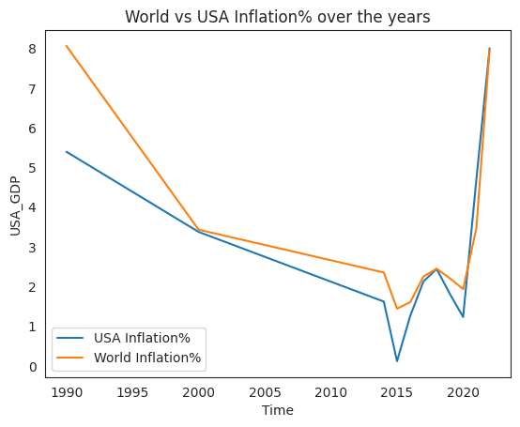
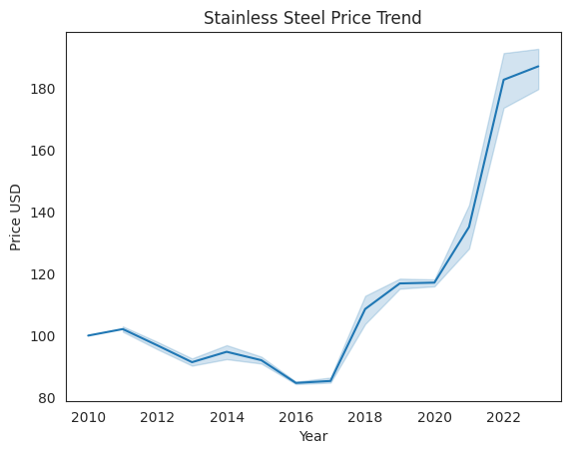
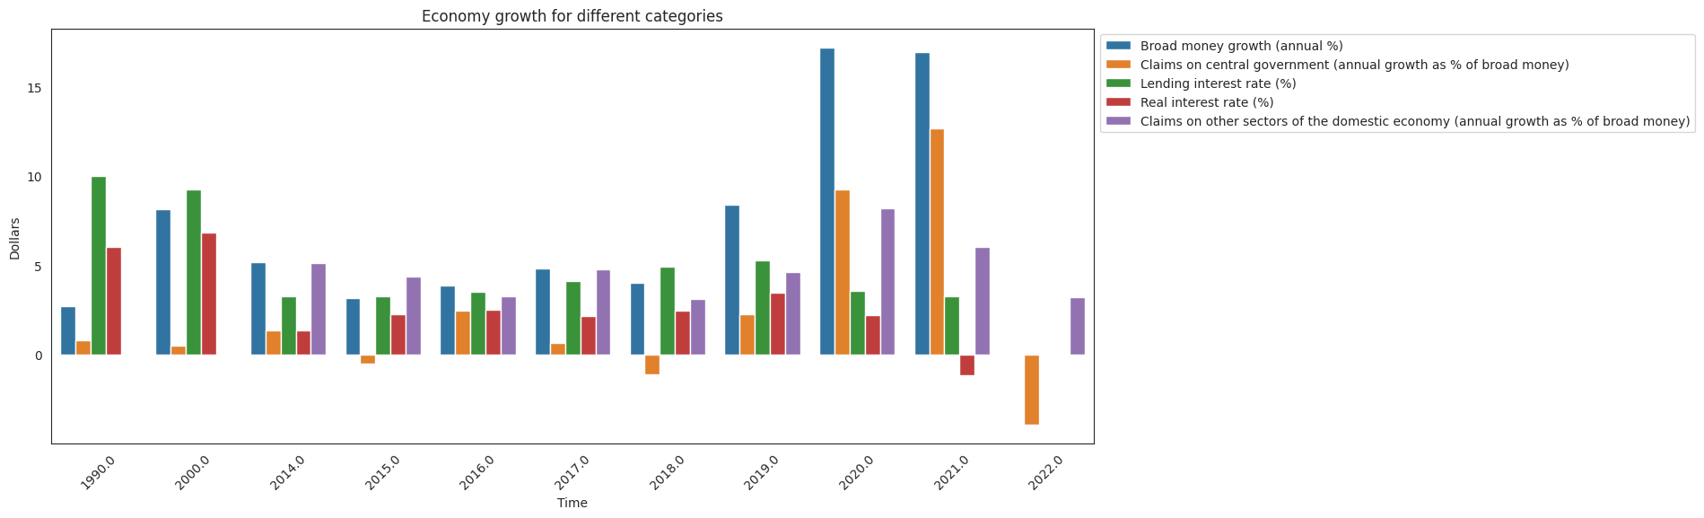
Economy Insight

Slide 8
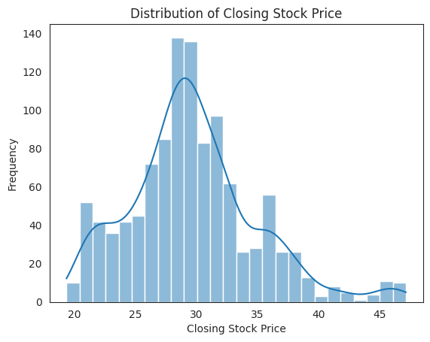
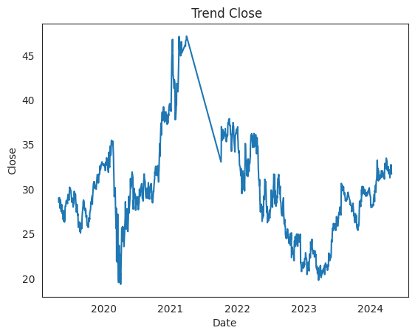
Financial Stock Market Performance

Slide 9
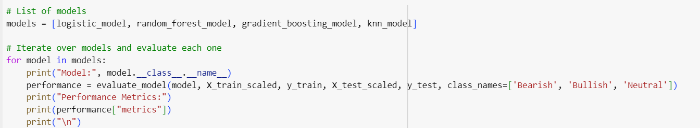
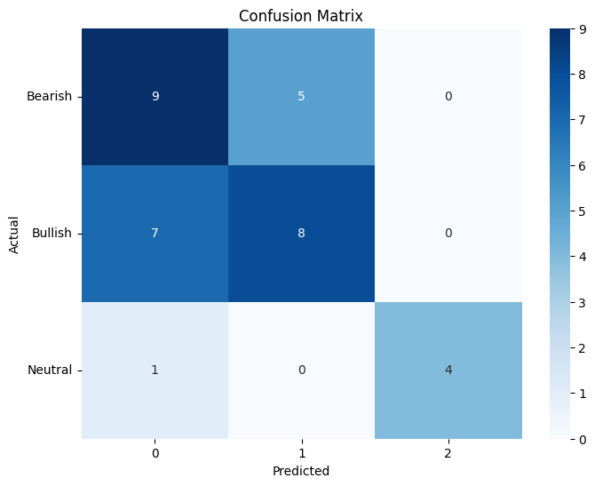
How we applied ML?
Best model was given by Logistic Classification

Slide 10
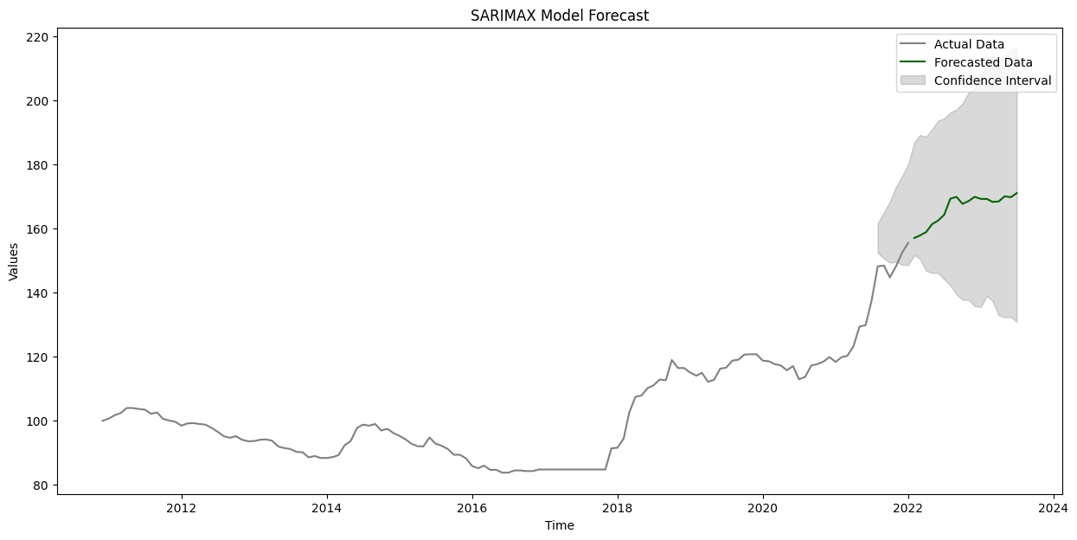
What was our outcome?
Stainless Steel Forecast

Slide 11
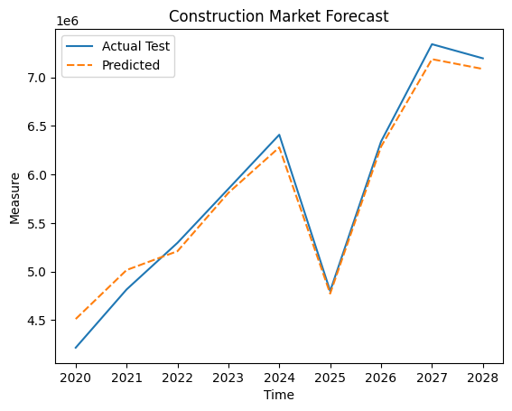
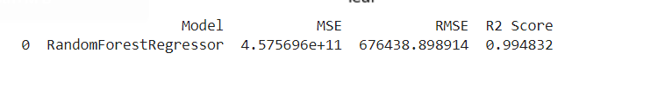
What was our outcome?

Slide 12
Summary
The result
The model predicted the market is bullish this and next year
The model predicted the construction market will be better in 2024 than 2023 but it will dip in 2025 significantly
The model predicted that stainless steel price will increase so commodity-based business will have to consider options to improve operational efficiency
The model prediction will avoid any impact to business top-line
The goal
Predict economy whether it will be bullish, bearish or neutral
Construction market will grow in current and next year
This leads to increase in stainless steel price
Overall top-line becomes predictable

Slide 13
